Slide 1
Distributed Clock Synchronization

Slide 2
Synchronization
Adjustment of a clock or watch to show the same time as another.
Synchronization is done in 2 types of system:
Centralized System
Distributed System

Slide 3
Centralized System
It has a shared memory concept.
Common Clock
Event ordering is clear because all events are timed with the same common clock
Thus, Synchronization is easier in Centralized System

Slide 4
Distributed System
No shared memory.
No common clock.
Every system has their own clock.
Thus, Synchronization is harder in Distributed System

Slide 5
Clock Synchronization
Assume 4 systems which are geographically at a very far distance.
Now, when these communicate, a distributed environment is created.
Now, when these communicate, we want to maintain the data that should be sent or received in a synchronized manner.
For this purpose only, we do the synchronization of clock.
BUT WHAT DO WE MEAN BY CLOCK SYNCHRONIZATION. WHAT IS IT?

Slide 6
Clock Synchronization
It is a mechanism to synchronize the time of all computers in a distributed environment
Challenge:
Clock Skew

Slide 7
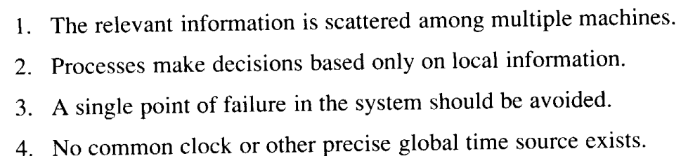
Clock Synchronization
Some Properties of Distributive Systems are:
Not acceptable to send request to a single manager processor.
System should not go down on failure of a single system.
Process A asks for the time followed by Process B, then Process B should get higher value than A

Slide 8
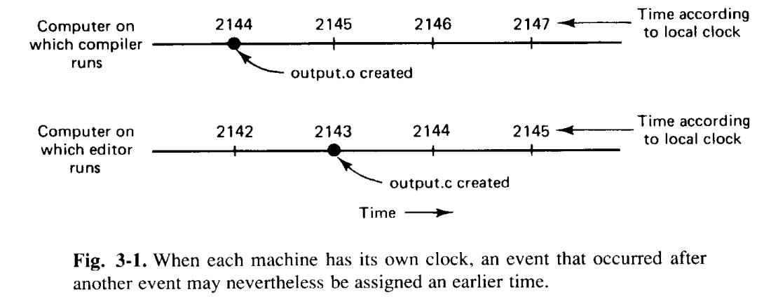
Clock Synchronization
Example of make system call

Slide 9
Types
Physical Clock Synchronization
Logical Clock Synchronization
Mutual Exclusion

Slide 10
Physical Clock Synchronization
Required for real-world applications
Problems:
Synchronize them with real-world clock
Synchronize with each other
Every system contains a physical clock which is used to timestamp an event on the system.
Techniques used in this are:
UTC (Universal Time Coordination)
Cristian’s Algorithm
Berkeley Algorithm

Slide 11
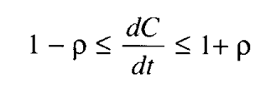
Clock Synchronization Algo
H: a timer that causes an interrupt H times a second
C: Value of the clock
when UTC time is t, the value of the clock on machine p is C_{p}(t).
Ideally C_{p}(t) = t for all p and all t i.e. dC/dt = 1

Slide 12
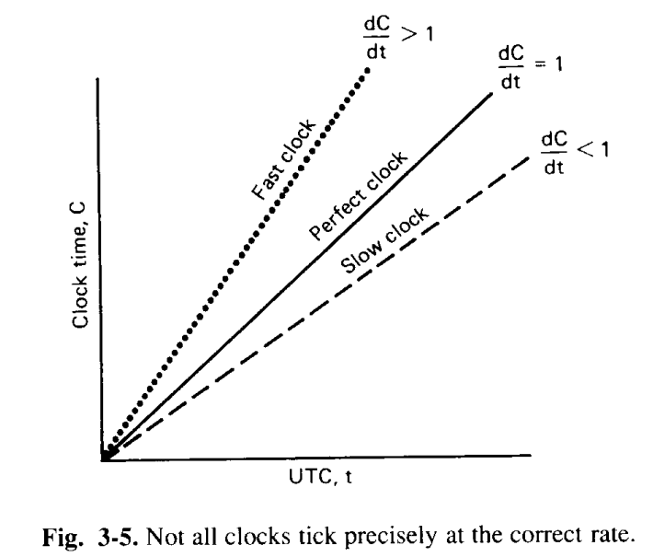
Clock Synchronization Algo
Maximum drift rate, is specified by the manufacturer

Slide 13

Cristian’s Algorithm
Simplest algorithm for setting time.
Issues a remote procedure call to the time server and issues the time.
Machine sends a request to time server in maximum
where p is the difference between a clock and UTC.
The time server then sends a reply with the current UTC.
Machine then measures the time difference of sending and receiving the reply from time server and uses this difference to adjust the clock.

Slide 14
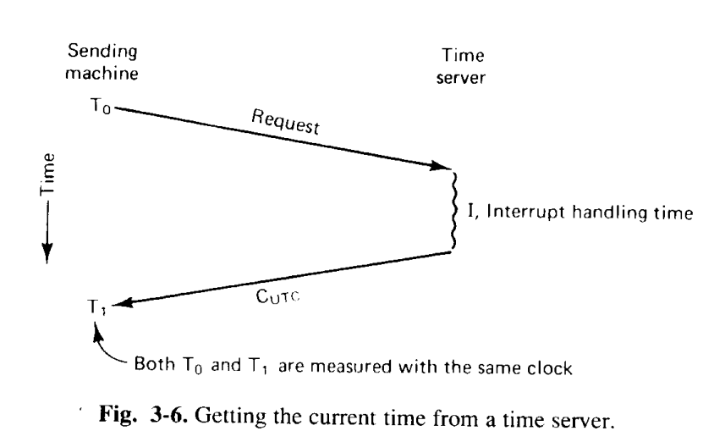
Cristian’s Algorithm

Slide 15
Cristian’s Algorithm (contd…)
So, the best estimate for message propagation time is (T₁-T₀)/2.
So, the new time now will be set as
T_{new} = T_{server}+ (T₁-T₀)/2
Where T_{server} is the current UTC time which was replied by the time server.

Slide 16
Cristian’s Algorithm (contd…)
Major Problem
C_{UTC} < C_{p}(t)
Solution?
Introduce changes gradually
Minor Problem
Estimation of propagation time?

Slide 17
Berkeley Algorithm
The server asks each machine their clock time, periodically and also tells its own time to them.
Then all machines replies the server with difference in their time with the time server.
Then server calculates the average time of all the clocks (including itself).
Based on the average time, it tells the machines to advance their clocks or slow their clocks, so as all the clocks are on the average time which was calculated.

Slide 18
Example:
3:00
3:00
3:00
0
3:00
3:00
-10
+25
2:50
3:25
2:50
3:25
3:00
3:05
+5
+15
-20
SYNCHRONIZED
2:50
3:25
3:05
3:05

Slide 19
Time Daemon
2:00
1:50
2:20
2:30

Slide 20
Logical Clock Synchronization
If 2 machines doesn’t interact, then there is no need to synchronize them.
Order of events occurring is important, not their time of occurrence.
So, logical time is not based on timing, but on order of events.
Can only move forward.
Logical time is obtained using interrupts to update the clock, more the interrupts, higher the overhead.
Most common logical clock synchronization algorithm is LAMPART’S ALGO. Used in situations where ordering is more important than time.

Slide 21
Lampart’s Algorithm
Follows “HAPPENED-BEFORE” concept.
a → b, means Event a happened before event b.
So, Time when a happened must be less than Time of b.
Therefore, C(a) < C(b).
Concurrent Events: If event a and b occur on 2 different systems and neither a → b nor b → a is true, then nothing can be said about whe they happened or which is happened first.

Slide 22
Algorithm:
Each message carries a timestamp of sender’s clock.
When message arrives:
If (receiver’s clock < message timestamp(sender’s)) set system clock to (message timestamp+1)
Else do nothing
Clock has to be always advanced between any two events in the same process or interacting processes.

Slide 23
Algorithm for sending and receiving
Sending
Receiving
Time = time +1;
Time_stamp = time;
Send(message, time_stamp)
Check (message,time_stamp)=receive()
Time = max(time_stamp,time)+1

Slide 24
Algorithm for sending and receiving (contd…)
There are 3 processes which are interacting with each other and each having their own clock. And each clock runs at different rate.
P₁
0
6
12
18
24
30
36
42
48
54
60
66
YES
P₂
0
8
16
24
32
40
48
56
64
72
80
88
P₃
0
10
20
30
40
50
60
70
80
90
100
110
T(P₁)<T(P₂)
m1
YES
T(P₂)<T(P₃)
m2
NO
T(P₃)<T(P₂)
NO
m3
T(P₂)<T(P₁)
m4

Slide 25
Lamparts algorithm corrects the clock now….
When message arrives:
If (receiver’s clock < message timestamp(sender’s)) set system clock to (message timestamp+1)
Else do nothing
P₁
0
6
12
18
24
30
36
42
48
54
60
66
P₁
0
6
12
18
24
30
36
42
48
70
76
82
P₂
0
8
16
24
32
40
48
61
69
77
85
93
P₃
0
10
20
30
40
50
60
70
80
90
100
110
P₂
0
8
16
24
32
40
48
56
64
72
80
88
m1
m2
m3
T(P₃) = 60
T(P₂) = 56
So, T(P₂)< T(P₃).
T(P₂) = T(P₃) + 1
= 60 +1
= 61
m4
Update these too

Slide 26
Use of Synchronized clocks
At-Most-Once Message Delivery (Liskov(1993))
Specially in the face of crashes
Traditional Approach:
Unique Number
Server store all the numbers of the messages it has seen so
Problem:
Server crashes and reboots
Loss of table of message numbers
How long should message numbers be saved?

Slide 27
Use of Synchronized clocks
Using time, modifications:
Message carries a connection identifier (chosen by sender) and a timestamp.
For each connection, Server records in a table the most recent timestamp stored for the connection, the message is rejected as a duplicate
Server maintains a global variable (G)
where MaxLifetime is the maximum time a message can live and MaxClockSkew is how far from UTC the clock might be at worst.

Slide 28
Use of Synchronized clocks
Any timestamp older than G can safely be removed
All messages that old have died out already.
If incoming message has unknown connection identifier, it is older than G because anything that old surely is a duplicate.
G is a summary if the messages numbers of all old messages.

Slide 29
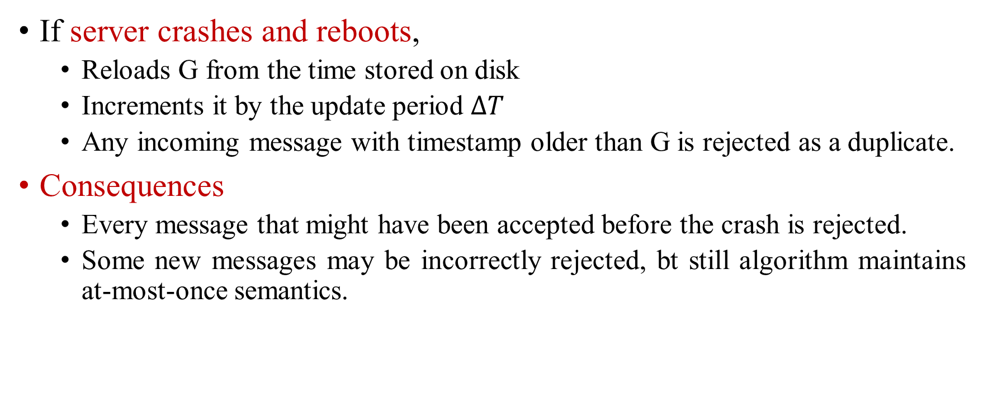
Use of Synchronized clocks
If server crashes and reboots,
Reloads G from the time stored on disk
Increments it by the update period $∆T$
Any incoming message with timestamp older than G is rejected as a duplicate.
Consequences
Every message that might have been accepted before the crash is rejected.
Some new messages may be incorrectly rejected, bt still algorithm maintains at-most-once semantics.

Slide 30
Use of Synchronized clocks
Clock-based Cache Consistency
Desirable is: each client to cache files locally
Consequences of cache?
If a client has a file cached for reading, before another client can get a copy for writing, the server has to first ask the reading client to invalidate its copy, even if the copy was made hours ago => Exta-overhead.
This can be resolved by using synchronized clocks.
Using concept of lease

Slide 31
Use of Synchronized clocks
When a client wants a file, it is given a lease on it that specifies how long the copy is valid.
When lease is about to expire, the client can ask for it to be renewed.
When a client needs to read once, it can ask for it.
When the lease expires, it just times out,
No need to explicitly send a message telling the server that it has been purged from the cache.
The cached copy may no longer be used
The client can ask the server if the copy it has is still the current one.
If Yes, a new lease is generated, but the file need not be retransmitted.

Slide 32
Use of Synchronized clocks
When on client wants to write on the file Writing
If one or more clients have a file cached for reading, the server has to ask the readers to prematurely terminate their leases.
If one or more crashes, the server can just wait until the dead server's lease times out.

Slide 33
Use of Synchronized clocks
In the traditional algo,
Permission- to-cache must be returned explicitly from the client to the server.
Problem:
If client does not response.
Server cannot tell if the client is dead or merely slow.
With the Timer-based algo, the server can just wait and let the lease expire.

Slide 34
Reference
A S Tanenbaum, Maarten Van Steen, Distributed Operating systems, Pearson, 2014

